Slide 1


DATA MINING
Name
1.Tanvir Ahmed Apu
2.Md Tajbeer Ahamed Rimon
3.Shariful Islam Sajib Sarkar
4.Sowrobh Bhuiyan
ID
1.212 505 1045
2.212 505 1007
3.212 505 1016
4.212 505 1026
Section:5A
Course Name: Artificial Intelligence
Course Code: C.S.E 316
Department: C.S.E
SUBMITTED TO:
NAME: FERDAUS ANAM JIBON
ASSISTANT PROFESSOR, UNIVERSITY OF INFORMATION TECHNOLOGY AND SCIENCES (UITS).
DEPARTMENT: C.S.E

Slide 2
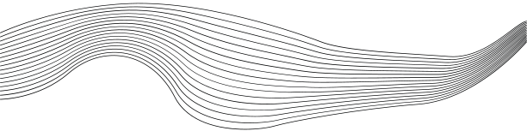
CONTENT
01
DEFINITION, MOTIVATION & APPLICATION
02
BRANCHES OF DATA MINING
03
CLASSIFICATION, CLUSTERING, ASSOCIATION RULE MINING
04
SOME CLASSIFICATION TECHNIQUES

Slide 3




WHAT IS DATA MINING?
Data mining (knowledge discovery in databases):
◦process of discovering valuable and useful patterns, trends, and insights from large amount data.
Alternative names and their “inside stories”:
◦Pattern Discovery
◦Knowledge discovery in databases (KDD), knowledge extraction, data/pattern analysis, data archaeology, business intelligence etc.

Slide 4

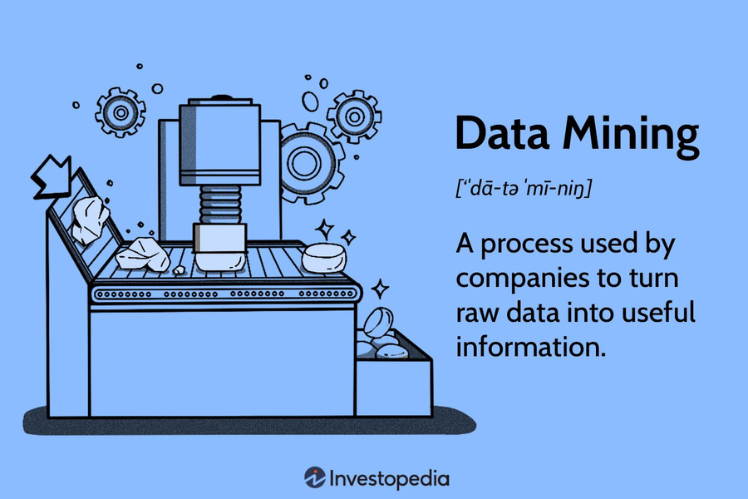
DATA MINING DEFINITION
Finding hidden information in a database
Fit data to a model
Data driven discovery

Slide 5

DATA EXPLOSION PROBLEM
◦ Automated data collection and advanced databases result in massive data accumulation in repositories.
We are drowning in data, but starving for knowledge!
Solution: Data warehousing and data mining
◦Data warehousing and on-line analytical processing
◦Extraction of interesting knowledge (rules, regularities,patterns, constraints) from data in large databases

Slide 6



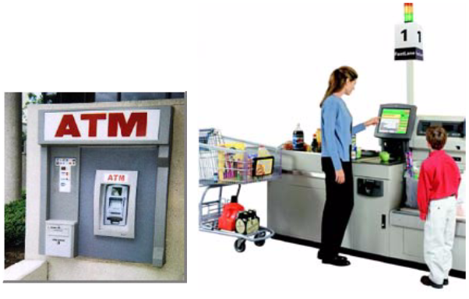
WHY MINE DATA IN COMMERCIAL VIEWPOINT?
Lots of data is being collected
and warehoused
◦Web data, e-commerce
◦purchases at department/
grocery stores
◦Bank/Credit Card
transactions
Computers have become cheaper and more powerful
Competitive Pressure is Strong
◦Provide better, customized services for an edge .

Slide 7

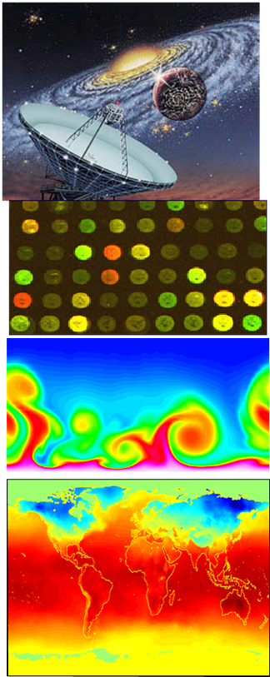
WHY MINE DATA? SCIENTIFIC VIEWPOINT
Data collected and stored at
enormous speeds (GB/hour)
◦remote sensors on a satellite
◦telescopes scanning the skies
◦microarrays generating gene
Expression data
◦scientific simulations
generating terabytes of data
Traditional techniques infeasible for raw data
Data mining may help scientists ◦in classifying and segmenting data

Slide 8
WHAT IS (NOT) DATA MINING?
What is not Data Mining?
–Look up phone number in phone directory
– Query a Web search engine for information about “Amazon”
What is Data Mining?
–Certain names are more prevalent in certain UK locations (John, Ron - New York city
– Group together similar documents returned by search engine according to their context (e.g. Google live , Google.com,)

Slide 9

DATABASE PROCESSING
DATA MINING PROCESSING
VS.
>Query
◦Well defined
◦SQL
>Data
– Operational data
>Output
– Precise
Subset of database
>Query
◦Poorly defined
◦No precise query language
>Data
– Not operational data
>Output
Fuzzy
Not a subset of database

Slide 10
DATA MINING: CLASSIFICATION SCHEMES
Decisions in data mining
◦Kinds of databases to be mined ◦Kinds of knowledge to be discovered
◦Kinds of techniques utilized
◦Kinds of applications adapted
Data mining tasks
◦Descriptive data mining
Predictive data mining

Slide 11


DECISIONS IN DATA MINING
Databases to be mined
◦Relational, transactional, object-oriented, object-relational, active, spatial, time-series, text, multi-media, heterogeneous, legacy, WWW, etc.
Knowledge to be mined
◦Characterization, discrimination, association, classification, clustering, trend, deviation and outlier analysis, etc.
◦Multiple/integrated functions and mining at multiple levels
Techniques utilized
◦Database-oriented, data warehouse (OLAP), machine learning, statistics, visualization, neural network, etc.
Applications adapted
◦Retail, telecommunication, banking, fraud analysis, DNA mining, stock market analysis, Web mining, Weblog analysis, etc.

Slide 12
DATA MINING TASKS
Prediction Tasks
◦Use some variables to predict unknown or future values of other variables
Description Tasks
◦Find human-interpretable patterns that describe the data.
◦Common data mining tasks
◦Classification [Predictive]
◦Clustering [Descriptive]
◦Association Rule Discovery [Descriptive]
◦Sequential Pattern Discovery [Descriptive]
◦Regression [Predictive]
◦Deviation Detection [Predictive]

Slide 13
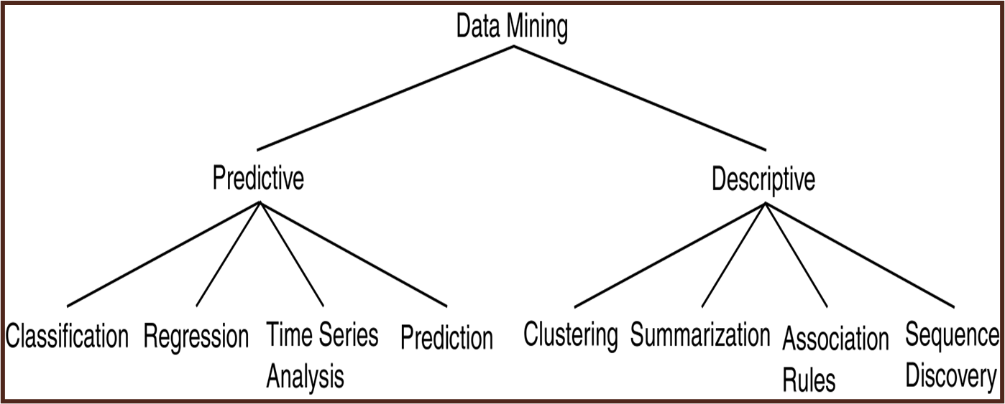
DATA MINING MODELS AND TASKS

Slide 14
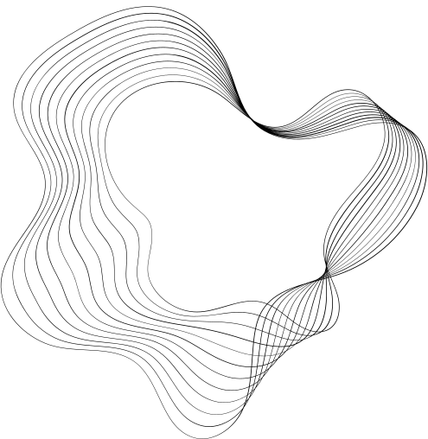
CLASSIFICATION

Slide 15
CLASSIFICATION: DEFINITION
Given a collection of records (training set )
◦Each record contains a set of attributes, one of the attributes is the class.
Find a model for class attribute as a function of the values of other attributes.
Goal: previously unseen records should be assigned a class as accurately as possible.
◦A test set is used to determine the accuracy of the model. Usually, the given data set is divided into training and test sets, with training set used to build the model and test set used to validate it.

Slide 16
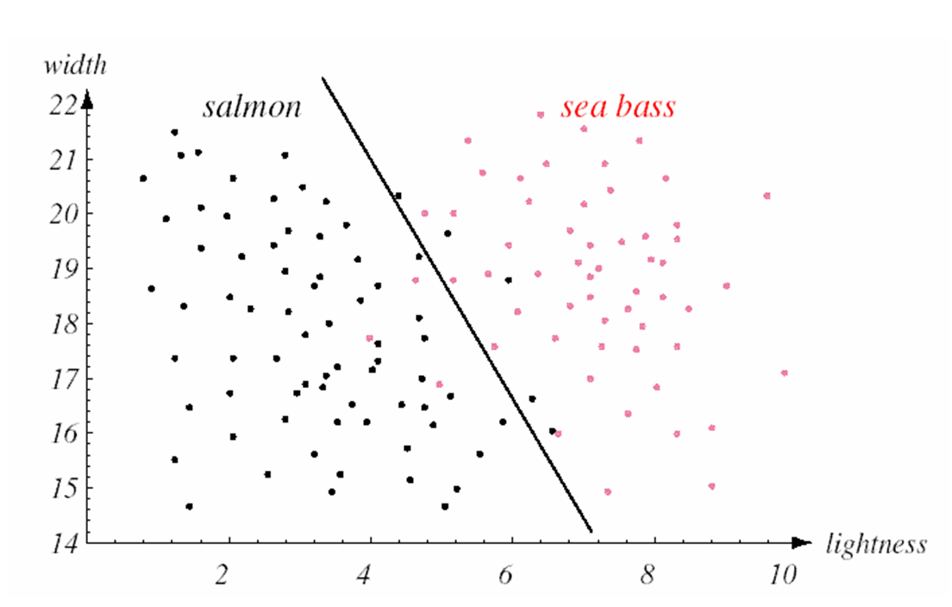
CLASSIFICATION: EXAMPLES-1

Slide 17
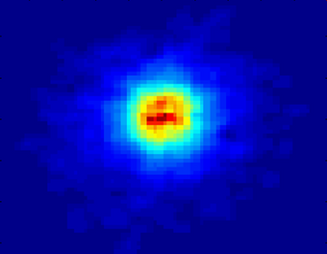
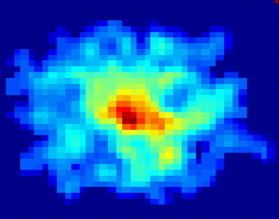
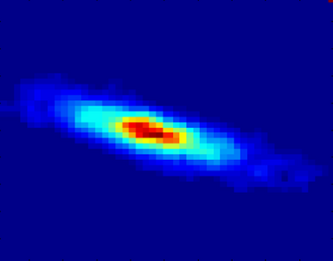
CLASSIFICATION: EXAMPLE-2
Class:
Stages of Formation
Early
End
Mid
Data Size:
72 million stars, 20 million galaxies
Object Catalog: 9 GB
Image Database: 150 GB
Attributes:
Image features,
Characteristics of light waves received, etc.

Slide 18
CLASSIFICATION: APPLICATION
1.Direct Marketing
◦Goal: Reduce cost of mailing by targeting a set of consumers likely to buy a new cell-phone product.
◦Approach:
2.Use the data for a similar product introduced before.
We know which customers decided to buy and which decided otherwise. This {buy, don’t buy} decision forms the class attribute.
3.Collect various demographic, lifestyle, and company-interaction related information about all such customers.
Type of business, where they stay, how much they earn, etc.

Slide 19
CLUSTERING

Slide 20
CLUSTERING DEFINITION
Given a set of data points, each having a set of attributes, and a similarity measure among them, find clusters such that
◦Data points in one cluster are more similar to one another.
◦Data points in separate clusters are less similar to one another.
Similarity Measures:
◦Euclidean Distance if attributes are continuous.
◦Other Problem-specific Measures.

Slide 21
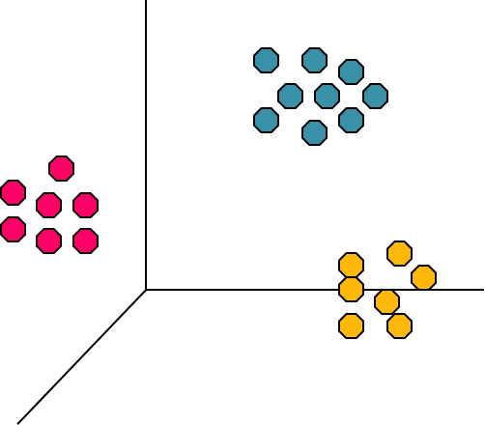
CLUSTERING:EXAMPLE-1
Euclidean Distance Based Clustering in 3-D space
Intracluster distances
are minimized
Intercluster distances
are maximized

Slide 22
ASSOCIATION RULE MINING

Slide 23
ASSOCIATION RULE DISCOVERY: DEFINITION
>Given a set of records each of which contain some number of items from a given collection;
>Produce dependency rules which will predict occurrence of an item based on occurrences of other items.

Slide 24
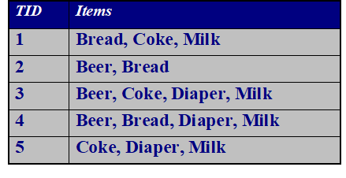
ASSOCIATION RULE DISCOVERY: EXAMPLE
Rules Discovered:
{Milk} --> {Coke}
{Diaper, Milk} --> {Beer

Slide 25
CLASSIFICATION TECHNIQUES

Slide 26
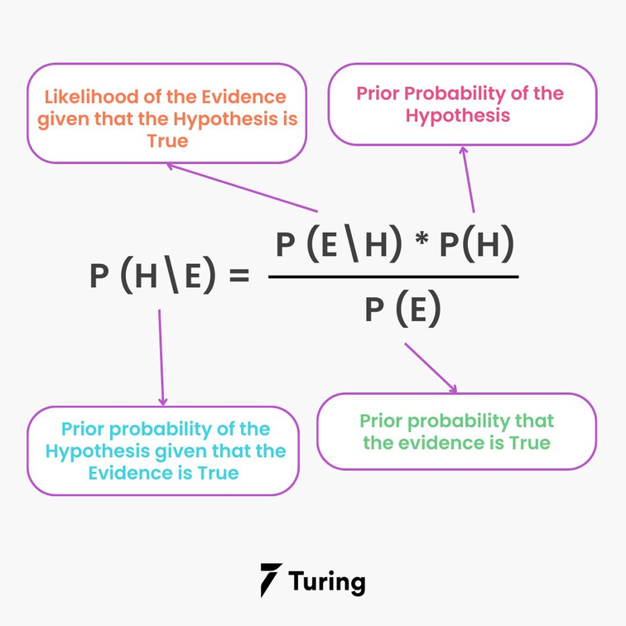
BAYES THEOREM
Bayes Theorem-based on the probability of a hypothesis, given the data and some prior knowledge. The naive Bayes classifier assumes that all features in the input data are independent of each other, which is often not true in real-world scenarios.

Slide 27
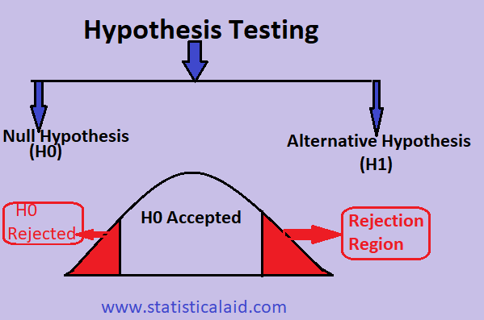
HYPOTHESIS TESTING
Find model to explain behavior by creating and then testing a hypothesis about the data.
Exact opposite of usual DM approach.
H0 – Null hypothesis;
Hypothesis to be tested.
H1 – Alternative hypothesis

Slide 28
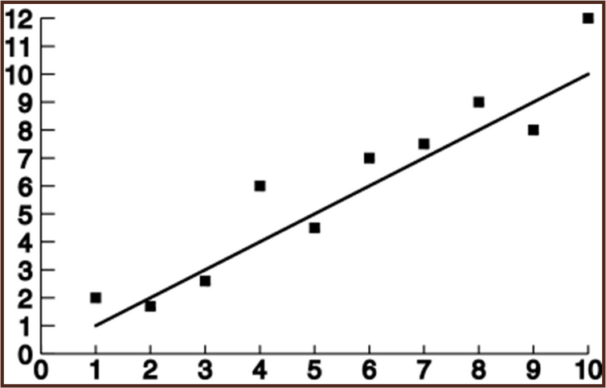
REGRESSION
Predict future values based on past values
Linear Regression assumes linear relationship exists.
y = c0 + c1 x1 + … + cn xn
Find values to best fit the data
Linear Regression

Slide 29
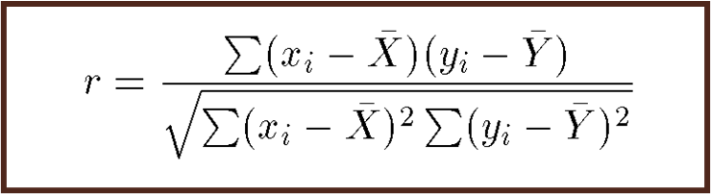
CORRELATION
Examine the degree to which the values for two variables behave similarly.
Correlation coefficient r:
•1 = perfect correlation
•-1 = perfect but opposite correlation
•0 = no correlation

Slide 30
DECISION TREES
Decision Tree (DT):
◦Tree where the root and each internal node is labeled with a question.
◦The arcs represent each possible answer to the associated question.
◦Each leaf node represents a prediction of a solution to the problem.
Popular technique for classification; Leaf node indicates class to which the corresponding tuple belongs.

Slide 31
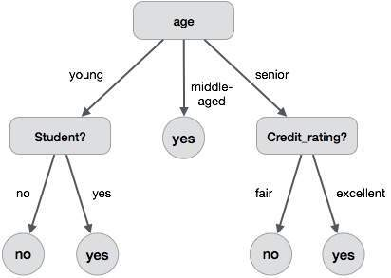
DECISION TREES:EXAMPLE-1

Slide 32
DECISION TREES
A Decision Tree Model is a computational model consisting of three parts:
◦Decision Tree
◦Algorithm to create the tree
◦Algorithm that applies the tree to data
Creation of the tree is the most difficult part.
Processing is basically a search similar to that in a binary search tree

Slide 33
DT ADVANTAGES/DISADVANTAGES
Advantages:
◦Easy to understand.
◦Easy to generate rules
Disadvantages:
◦May suffer from overfitting.
◦Does not easily handle nonnumeric data.
◦Can be quite large – pruning is necessary.

Slide 34
DATA MINING USAGES

Slide 35
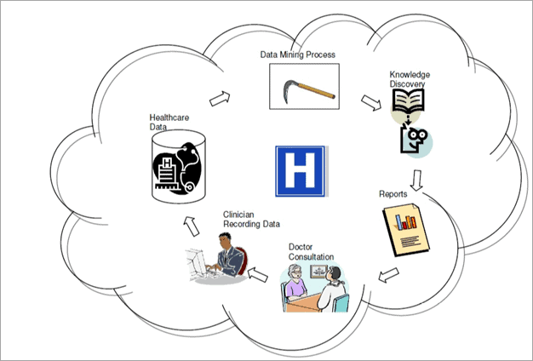
USE OF DATA MINING
In healthcare, data mining is becoming increasingly popular and essential.
Data generated by healthcare is complex and voluminous. To avoid medical fraud and abuse, data mining tools are used to detect fraudulent items and thereby prevent loss.

Slide 36
DATA MINING-FUTURE?

Slide 37

DATA MINING - FUTURE ?
>Future trend of data mining is expected to continue evolving with advancements in artificial intelligence and machine learning, leading to more sophisticated and automated data analysis techniques.
>There will be a growing focus on ethical considerations and data privacy, as well as the integration of data mining into various industries to make data-driven decisions.

Slide 38
CONCLUSION

Slide 39
CONCLUSION
Data mining will play an increasingly crucial role in extracting valuable insights from large datasets, driving innovation, and informing decision-making processes across various domains.

Slide 40

THANK YOU

